Slide 1
Array-Based Implementations

Slide 2
The Approach
An ADT is
  A collection of data … and …
  A set of operations on that data
Specifications indicate
  What ADT operations do
  But not how to implement
First step for implementation
  Choose data structure

Slide 3
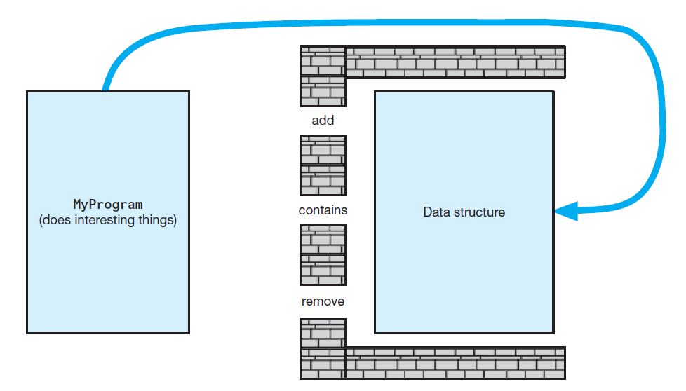
The Approach
Violating the wall of ADT operations

Slide 4
Core Methods
Poor approach
  Define entire class and attempt test
Better plan – Identify, then test basic (core) methods
  Create the container (constructors)
  Add items
  Display/list items
  Remove items

Slide 5
Using Fixed-Size Arrays
Must keep track of array elements used, available
Decide if first object goes in element 0 or 1
Consider if the add method places elements in consecutive elements of array
What happens when add method has used up final available element?

Slide 6
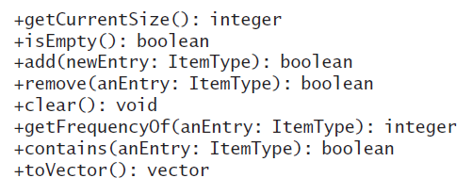
Array-Based Implementation of ADT Bag
Core ArrayBag methods

Slide 7
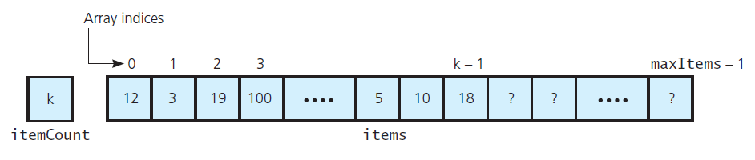
Array-Based Implementation of ADT Bag
An array-based implementation of the ADT bag

Slide 8
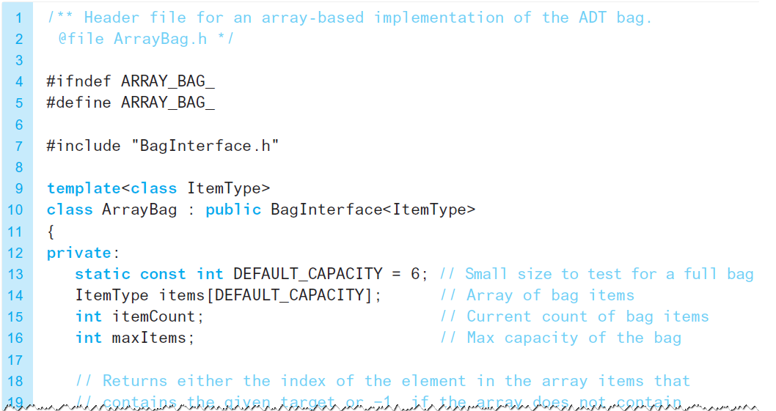
The Header File
LISTING 3-1 The header file for the class ArrayBag

Slide 9
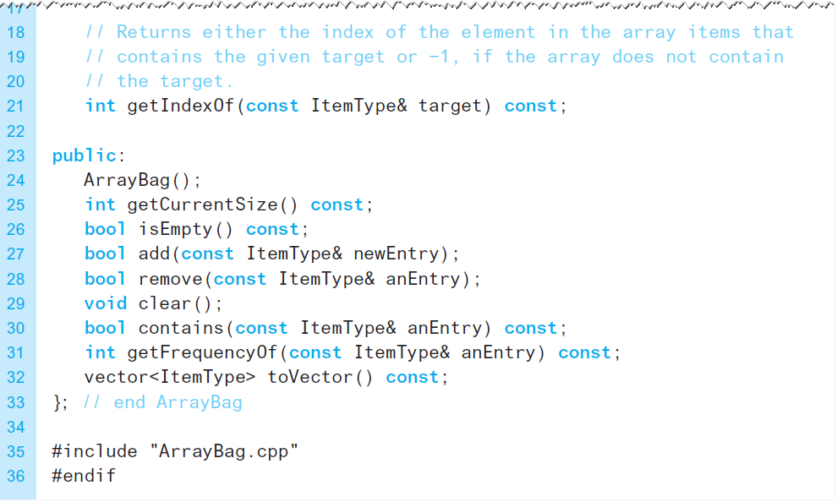
The Header File
LISTING 3-1 The header file for the class ArrayBag

Slide 10
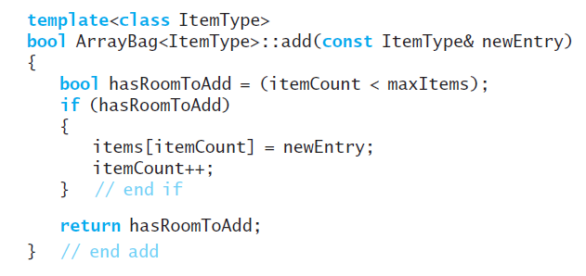
Defining the Core Methods
The method add

Slide 11
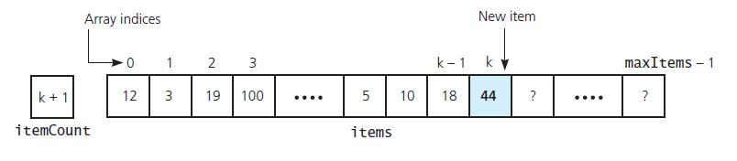
Defining the Core Methods
Inserting a new entry into an array-based bag

Slide 12
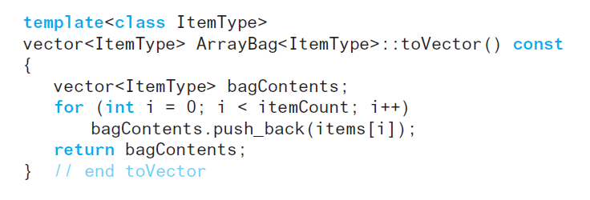
Defining the Core Methods
The method toVector

Slide 13
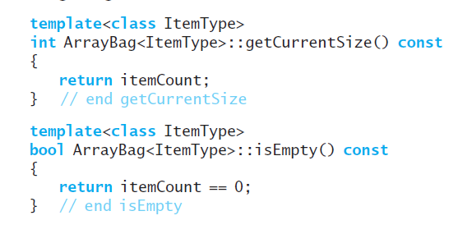
Defining the Core Methods
Methods getCurrentSize and isEmpty

Slide 14
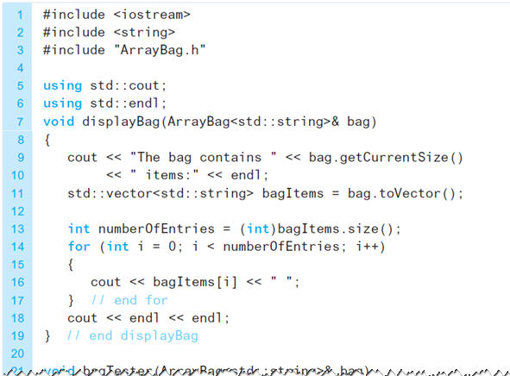
Testing the Core Methods
A program that tests the core methods
of the class ArrayBag

Slide 15
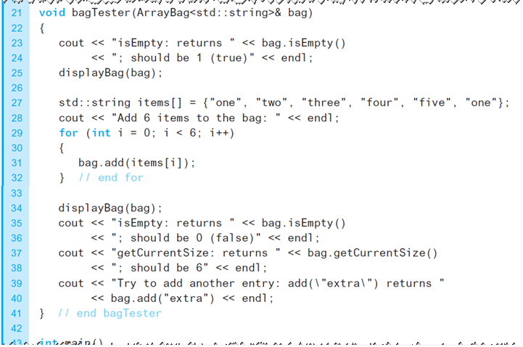
Testing the Core Methods
A program that tests the core methods
of the class ArrayBag

Slide 16
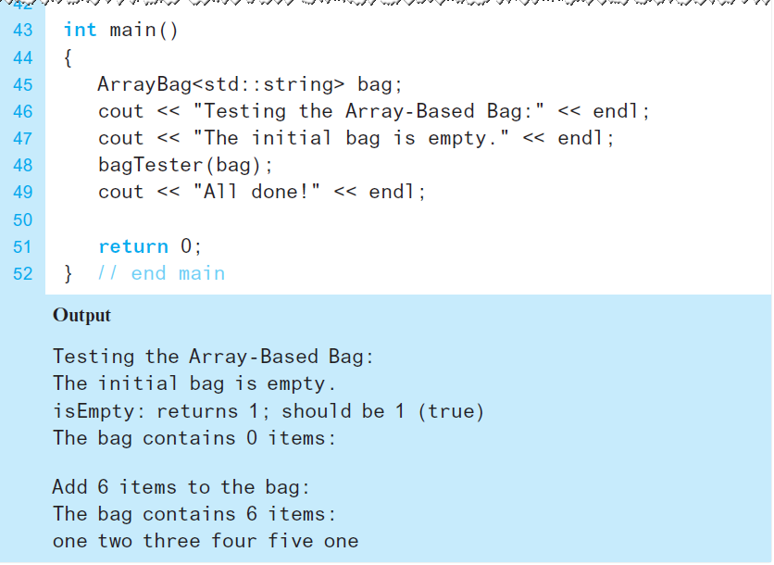
Testing the Core Methods
A program that tests the core methods
of the class ArrayBag

Slide 17
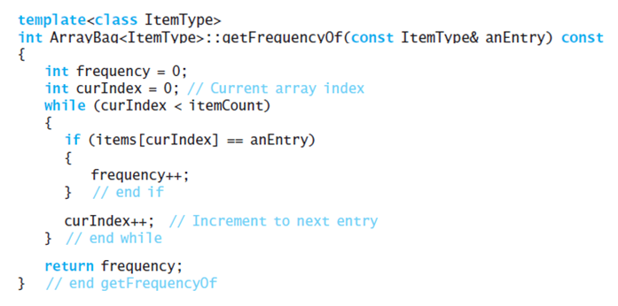
Implementing More Methods
Method getFrequencyOf

Slide 18
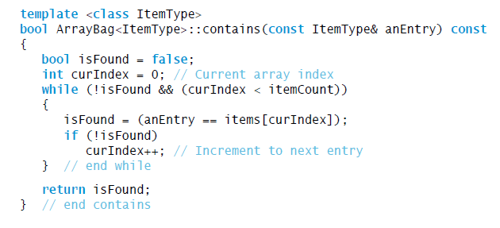
Implementing More Methods
Possible implementation of method contains

Slide 19
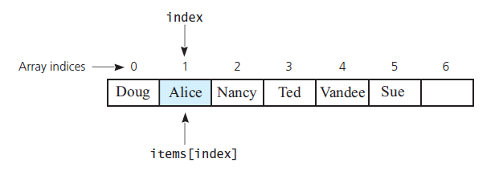
Methods That Remove Entries
The array items after a successful
search for the string "Alice"

Slide 20
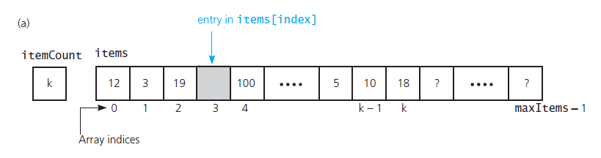
Methods That Remove Entries
(a) A gap in the array items after the entry in items[index] and decrementing itemCount;

Slide 21
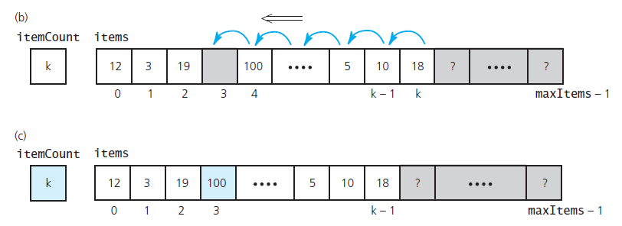
Methods That Remove Entries
(b)shifting subsequent entries to avoid a gap;
(c) the array after shifting

Slide 22
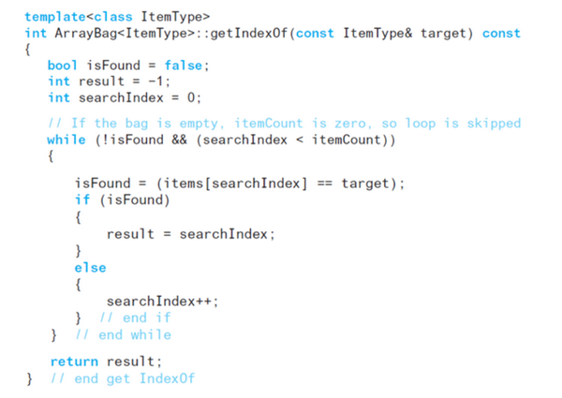
Methods That Remove Entries
Method getIndexOf

Slide 23
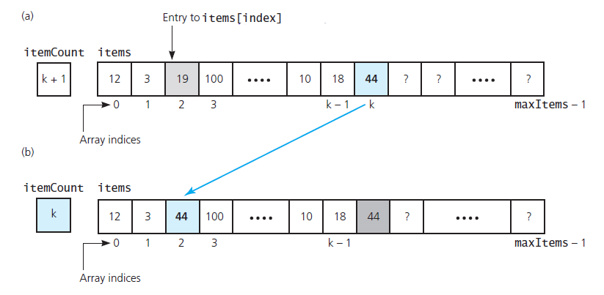
Methods That Remove Entries
Avoiding a gap in the array while removing an entry

Slide 24
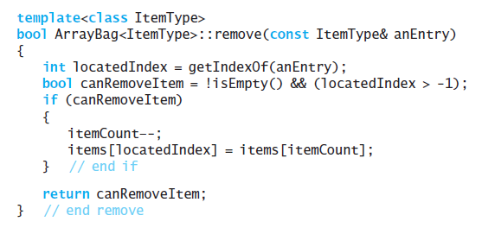
Methods That Remove Entries
Method remove

Slide 25
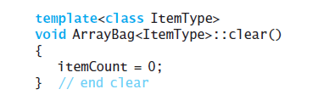
Methods That Remove Entries
Method clear

Slide 26
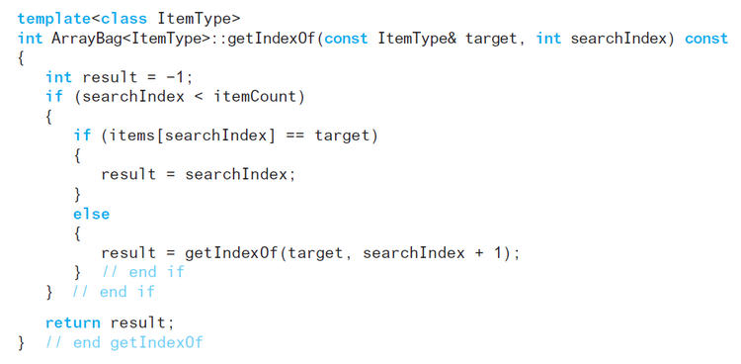
Recursion in the Implementation
Method getIndexOf

Slide 27
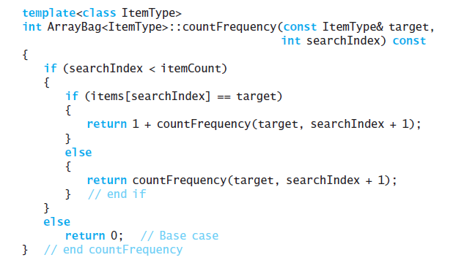
Recursion in the Implementation
Method countFrequency

Slide 28
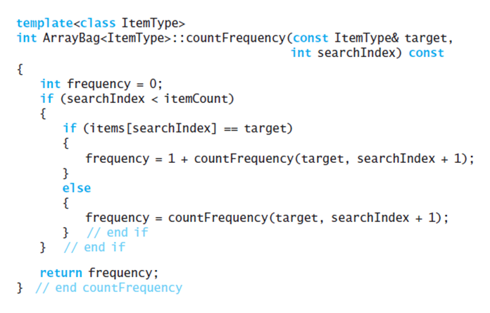
Recursion in the Implementation
Alternative method countFrequency

